Slide 1

Tools and Review
REPL
Eclipse and Pydev
Python Review
Zoo

Slide 2

See Also
https://www.informatics.indiana.edu/rocha/academics/i-bic/lab1/Python%20review.pdf
https://www.python.org/about/gettingstarted/
http://www.pydev.org/
Notes:
Here is some additional reading about the web … on the web

Slide 3
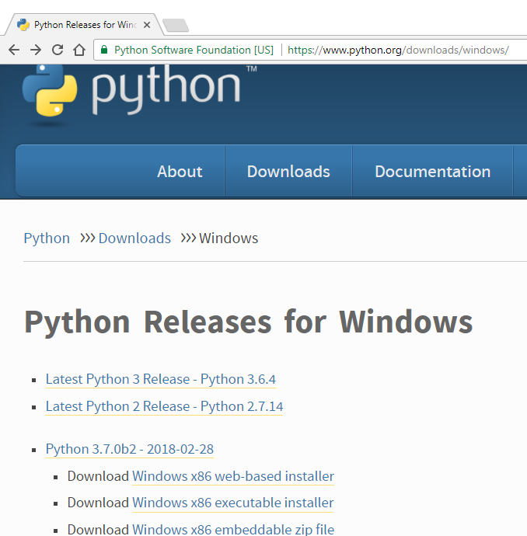
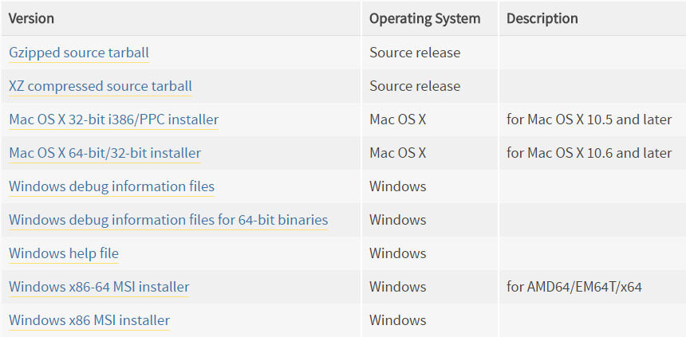
Installing Python
https://www.python.org/downloads/windows/

Slide 4
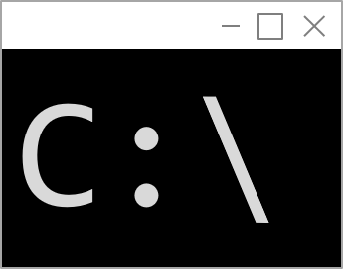
The Command Line
Command Prompt
C:\UAH>py
Python 3.6.4 (v3.6.4:d48eceb, Dec 19 2017, 06:54:40) [MSC v.1900 64 bit (AMD64)] on win32
Type "help", "copyright", "credits" or "license" for more information.
>>> 1+2
3
>>> print(5+5)
10
>>> for x in range(2,5):
... print(x)
...
2
3
4
>>> quit()
C:\UAH>

Slide 5
Python 2.x or 3.x
https://www.dataquest.io/blog/python-2-or-3/
Python 3.x started in 2008 (a DECADE ago)
The versions are incompatible
Nearly all popular libraries support Python 3 now
Python 2.x is scheduled end-of-life in 2020
Django version 2.0 does not support Python version 2.x
Learn Python 3.x

Slide 6
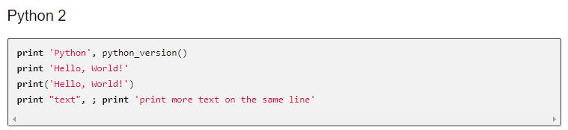
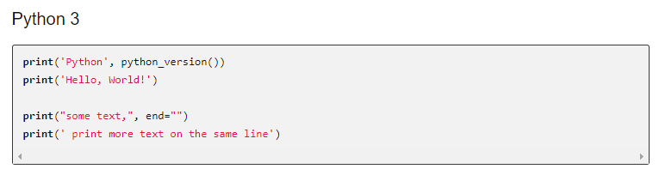
Python 2.x vs 3.x
http://sebastianraschka.com/Articles/2014_python_2_3_key_diff.html

Slide 7
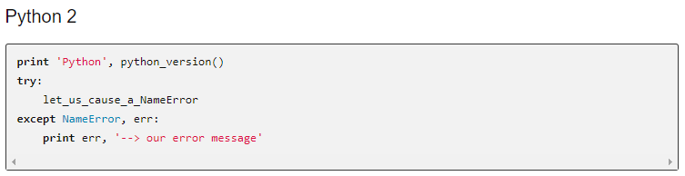
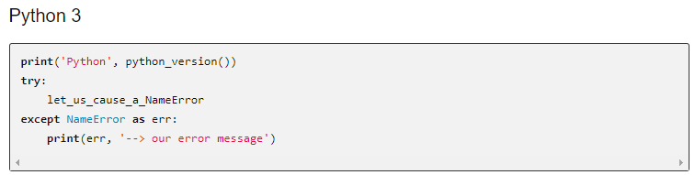
Python 2.x vs 3.x

Slide 8
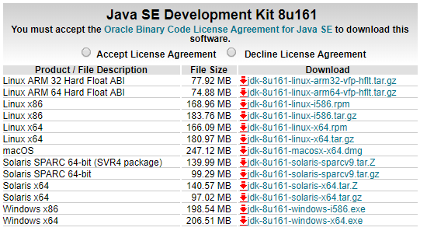

Pydev and Eclipse
http://www.oracle.com/technetwork/java/javase/downloads/jdk8-downloads-2133151.html
https://www.eclipse.org/downloads/

Slide 9
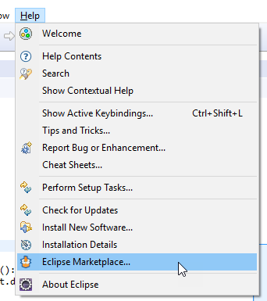
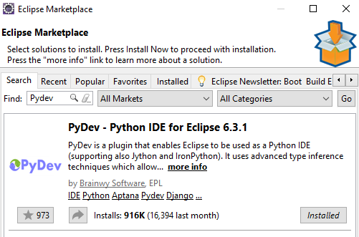
Pydev and Eclipse

Slide 10
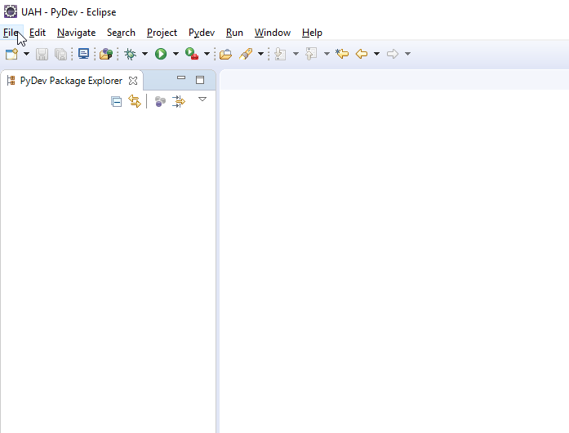
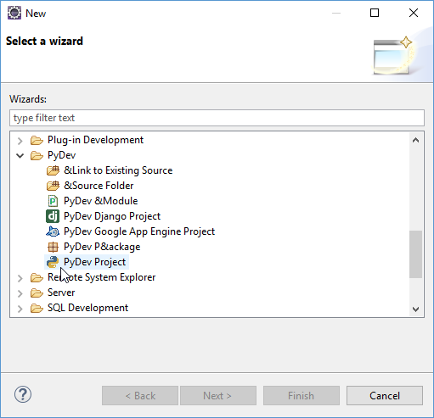
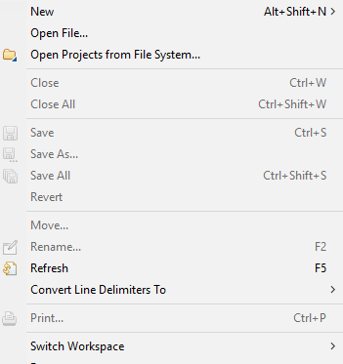
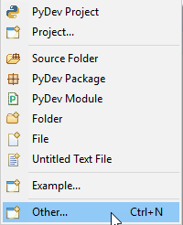
New Project

Slide 11
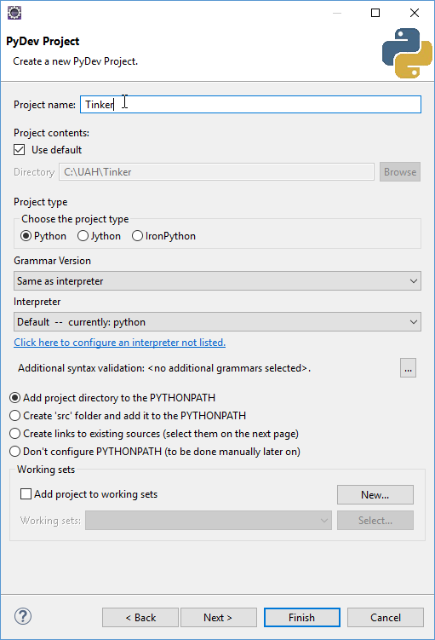
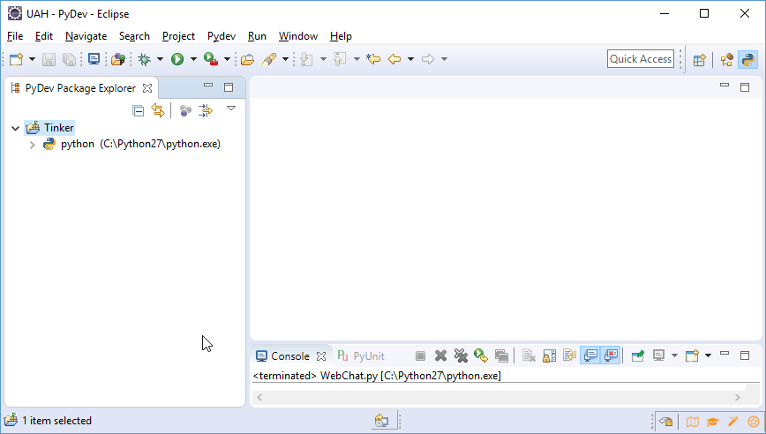
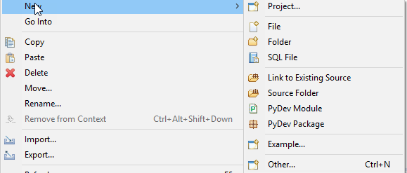
New Project

Slide 12
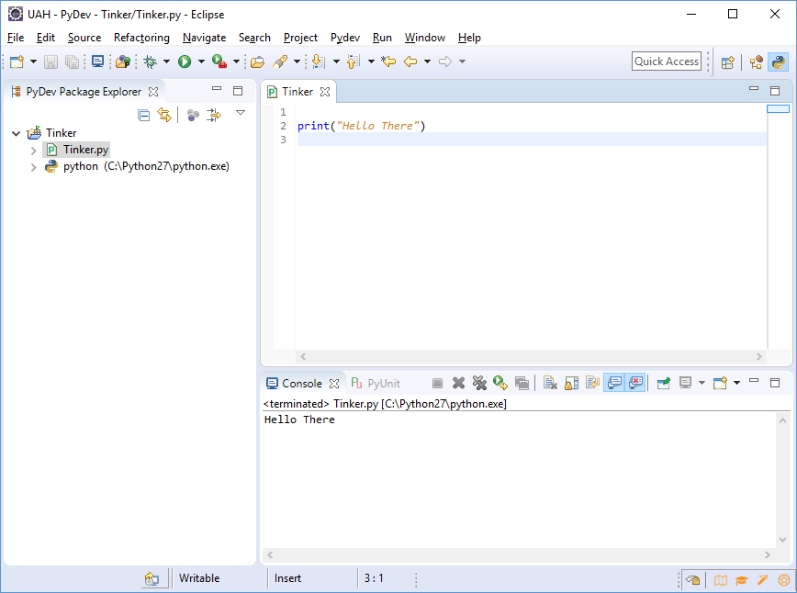
New Project

Slide 13
Review: Functions
Functions take arguments and return values
You can return multiple things
Variables declared in a function are transient locals
def getYesNo(prompt):
ret = input(prompt).capitalize()[0]
# This is a comment
return 1234, ret
i = getYesNo("First ")
print(i)
print(i[0])
i,j = getYesNo("Second ")
print(i)
print(j)

Slide 14
Review: Variables
a = 5.2
b = a + 2
c = False
d = None
g = [1,2,3,"Hello",4]
print(g[2])
print(g[3])
del g[2]
g.append("World")
print g
3
Hello
[1, 2, 'Hello', 4, 'World']

Slide 15
Everything is a Pointer
More in a later lecture
>>> a = [1,2,3]
>>> a.append(a)
>>> a[3][3][3][3][3][3][3][3][3][3][3][3][3][3][3][3][3][2]
3
>>>

Slide 16
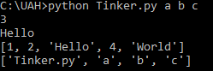
Command Line Arguments
import sys
print(sys.argv)
print(sys.argv[1])

Slide 17
Dictionaries
TODO

Slide 18
Example: The Zoo
animals = {
"Question" : "Does it live on land?",
"No" : "Fish",
"Yes" : {
"Question": "Does it fly?",
"Yes" : "Bird",
"No" : "Cow"
}
}
def getYesNo(prompt):
ret = input(prompt).capitalize()[0]
if ret=="Y":
return "Yes"
return "No"
node = animals
while True:
ans = getYesNo(node["Question"]+" ")
next_node = node[ans]
if type(next_node) is not str:
node = next_node
continue
got_it = getYesNo("Is it a "+next_node+"? ")
Streams of bytes … two ways (into your program and out of your program)
Disks, consoles, sockets, keyboards, printers
Know how to talk streams and you can talk to anything
Initialization (constructor) is different. Use is the same.

Slide 19
Example: The Zoo
if got_it == 'Yes':
print("Let's play again.")
node = animals
continue
print "You stumped me."
new_animal = input("What were you thinking of? ")
new_ques = input("Give me a question to separate "+next_node+" from "+new_animal+": ")
yn = getYesNo("And what would the Y/N answer be for "+new_animal+"? ")
new_node = {"Question":new_ques}
if yn=='Yes':
new_node['Yes'] = new_animal
new_node['No'] = next_node
else:
new_node['Yes'] = next_node
new_node['No'] = new_animal
node[ans] = new_node
print("Let's play again.")
node = animals
Streams of bytes … two ways (into your program and out of your program)
Disks, consoles, sockets, keyboards, printers
Know how to talk streams and you can talk to anything
Initialization (constructor) is different. Use is the same.

Slide 20
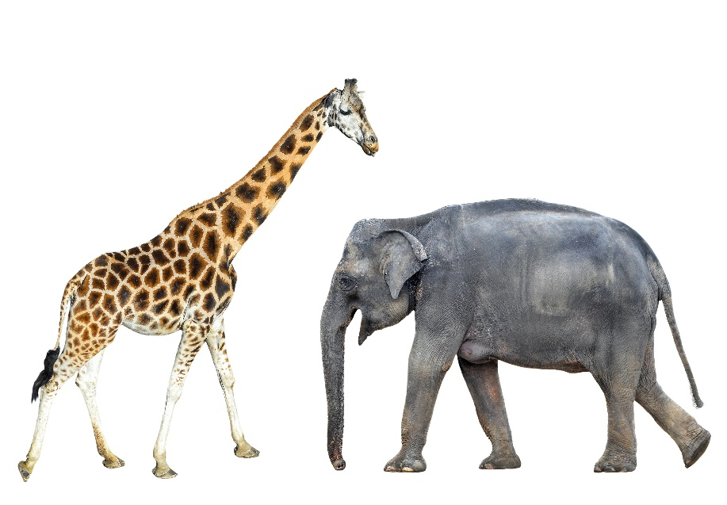
Tinkering
Create an empty Pydev project in Eclipse.
Type in the Zoo example
How could you load the zoo at the beginning of the game and save it when a new animal is added?

